Slide 1

Analyzing Sales Data of Amazon

Slide 2
Project Overview
To analyze Amazon's sales data to gain insights into sales trends and identify factors affecting sales across different branches.
Product Analysis
Sales Analysis
Customer Analysis
Tools Used – EXCEL & MYSQL Workbench
1000 Rows & 17 columns

Slide 3
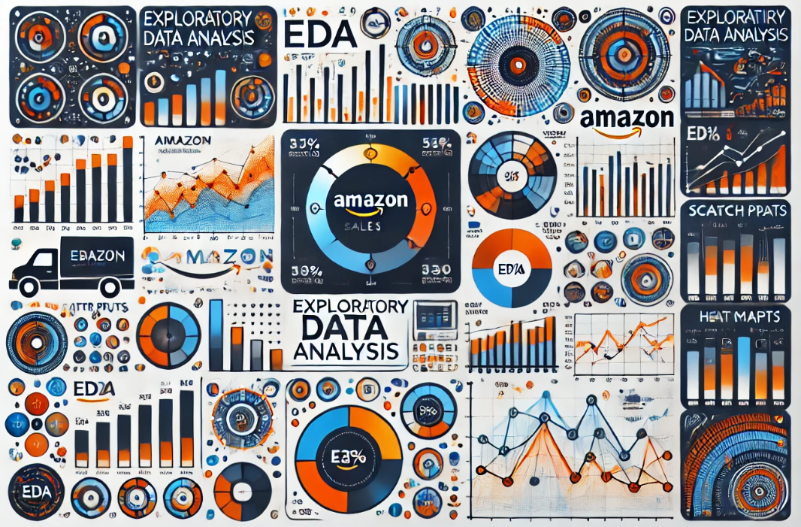
EDA
Created Database Amazon
Created table and imported dataset
Added columns using Date column:
Timeofday
Dayname
monthname

Slide 4
Insights
There are 3 distinct cities: Yangon, Naypyitaw, Mandalay.
There are 3 branches with corresponding cities Branch A- Yangon, B- Naypyitaw & C- Mandalay.
There are 6 distinct product lines.
The most frequently used payment method is E-wallet, with 345 transactions.
The Food & beverages product line has the highest sales with 53471.28.
Revenue for each month Jan-110754.16, Mar-104243.34,Feb- 92589.88.
In Jan, the cost of goods sold reach its peak with 110754.16.
The Food and beverages product line generated the highest revenue with 53471.28.
The Naypyitaw city was the highest revenue with 105303.53.

Slide 5
Food and beverages product line incurred the highest Value Added Tax with 2673.56.
For each product line, added a column named as Sales_rating. "Good" if its sales are above average, otherwise "Bad.“
Branch A exceeded the average number of products sold.
Health and beauty Product line is most frequently associated with gender Male and Fashion accessories is with gender female.
Average rating for each product line:
Yangon, Naypyitaw, Mandalay cities having highest VAT percentage, 4.76
Member customer type has the highest revenue.
Health and beauty | 7
Electronic accessories | 6.92
Home and lifestyle | 6.84
Sports and travel | 6.92
Food and beverages | 7.11
Fashion accessories | 7.03

Slide 6
Sales occurrences for each time of day on every weekday:
Member customer type has the highest VAT percentage.
There are 2 distinct customer types – Member & Normal.
There are 3 distinct payment methods – Ewallet, Cash & Credit card
Member customer type occurred most frequently with the highest purchase frequency.
Female customers are the predominant gender.
The distribution of genders within each branch:
Customers provide the most ratings during the afternoon.
dayname. | timeofday | Sales_Count
Saturday | Afternoon | 81
Wednesday | Afternoon | 81
Thursday | Afternoon | 76
Monday | Afternoon | 75
Friday | Afternoon | 74
Tuesday | Afternoon | 71
Sunday | Afternoon | 70
Saturday | Evening | 55
Tuesday | Evening | 51
Sunday | Evening | 41
Wednesday | Evening | 40
Tuesday | Morning | 36
Friday | Evening | 36
Thursday | Morning | 33
Friday | Morning | 29
Monday | Evening | 29
Thursday | Evening | 29
Saturday | Morning | 28
Sunday | Morning | 22
Wednesday | Morning | 22
Monday | Morning | 21
branch | gender | Count
A | Female | 161
A | Male | 179
B | Female | 162
B | Male | 170
C | Female | 178
C | Male | 150

Slide 7
The time of day with the highest customer ratings for each branch is shown below:
Monday is the day of the week with the highest average rating, 7.15.
The day of the week with the highest average ratings for each branch:
branch | timeofday | max_rating
A | Afternoon | 10
B | Afternoon | 10
B | Evening | 10
B | Morning | 10
C | Afternoon | 10
branch | dayname | avg_rating
B | Monday | 7.34
A | Friday | 7.31
C | Friday | 7.28

Slide 8
recommendations
Use social media and influencer marketing to target the female demographic effectively.
Target female customers with fashion accessories campaigns and afternoon offers.
Launch loyalty programs and exclusive member deals to drive higher revenue.
Align promotions with high customer ratings during afternoons.
Offer cashback and rewards to encourage frequent use.

Slide 9

THANK YOU

